Slide 1

SEED
Building Energy Management System
Johnson Controls

Slide 2
SEED – Structure Energy Efficiency Dashboard
SEED is an analysis tool developed by Johnson Controls producing charts and reports to evaluate energy usage in buildings, campuses and other facilities.
Data sources: Metasys ADS, BACnet Devices/Meters, OPC Devices/Meters
Master meters and Virtual Meters with Expressions
Multiple Energy Report Types
Export Reports to Excel and PDF
Web-Based UI to provide an optimal viewing and interaction experience across a wide range of devices from desktop computer monitors to mobile phones
REST API to be integrated by other systems
Optional Amazon AWS Cloud Deployment
Energy Usage Alarms
Asset Management

Slide 3
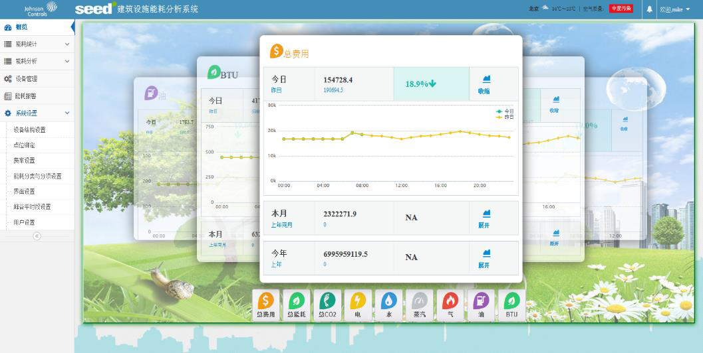
Energy Dashboard
displays summary of energy use and costs
Fig. 1. On a 4:3 projector setup a widescreen (16:9) slide with either have ‘dead-space’ above and below (left) or be stretched to fit (right) the projected area.

Slide 4
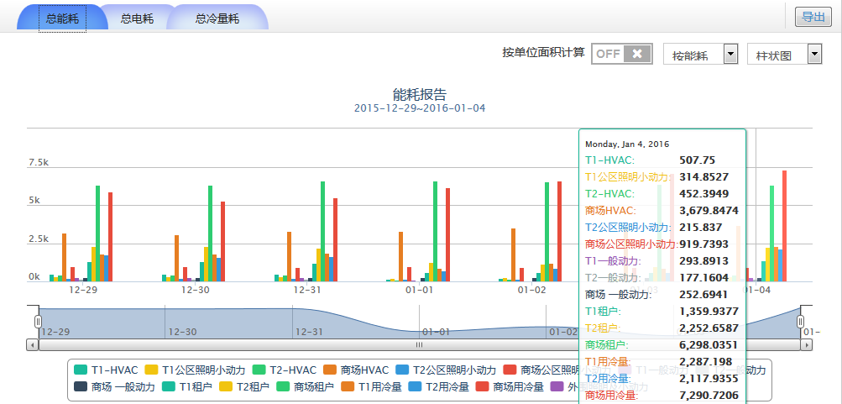
Energy Profile Report
shows energy use and costs of selected spaces and meters
Fig. 1. On a 4:3 projector setup a widescreen (16:9) slide with either have ‘dead-space’ above and below (left) or be stretched to fit (right) the projected area.

Slide 5
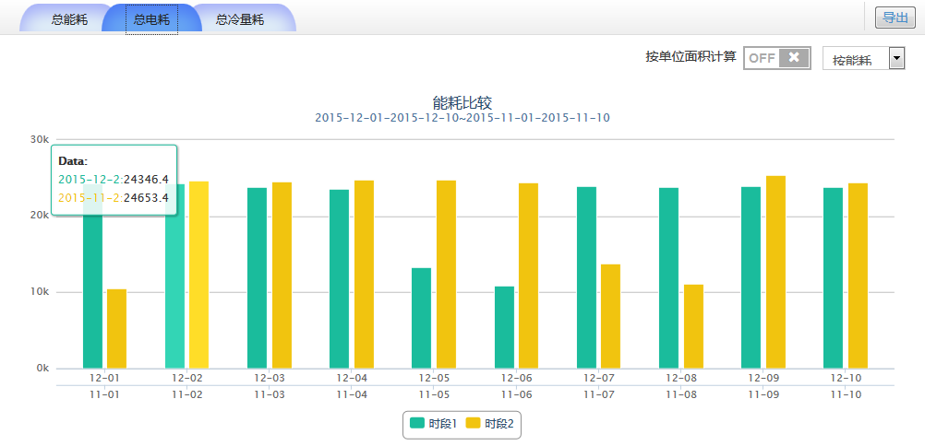
Energy Comparison
shows energy use versus different time periods or different sources

Slide 6
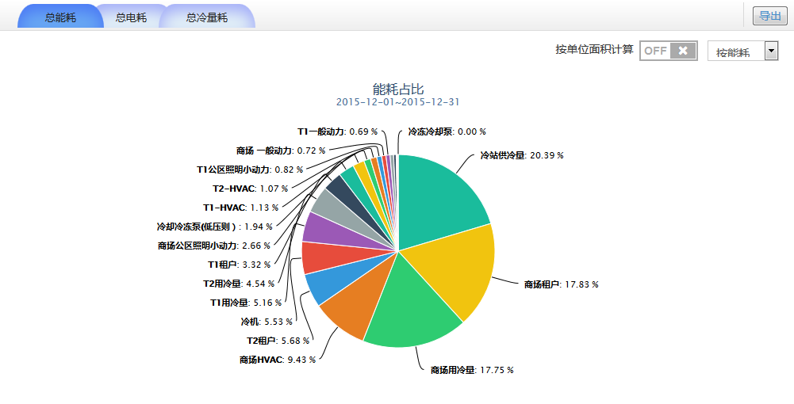
Energy Proportion
shows energy use percentage for all selected sources
Fig. 1. On a 4:3 projector setup a widescreen (16:9) slide with either have ‘dead-space’ above and below (left) or be stretched to fit (right) the projected area.

Slide 7
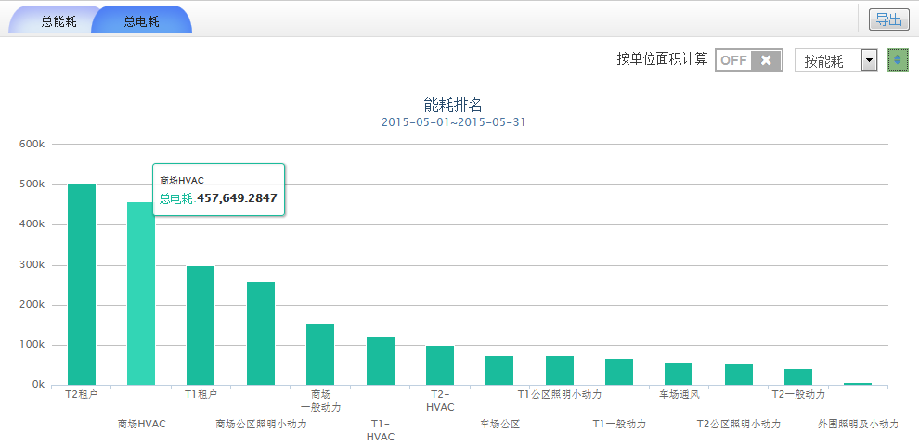
Energy Ranking
displays energy in descending order for the selected period
Fig. 1. On a 4:3 projector setup a widescreen (16:9) slide with either have ‘dead-space’ above and below (left) or be stretched to fit (right) the projected area.

Slide 8
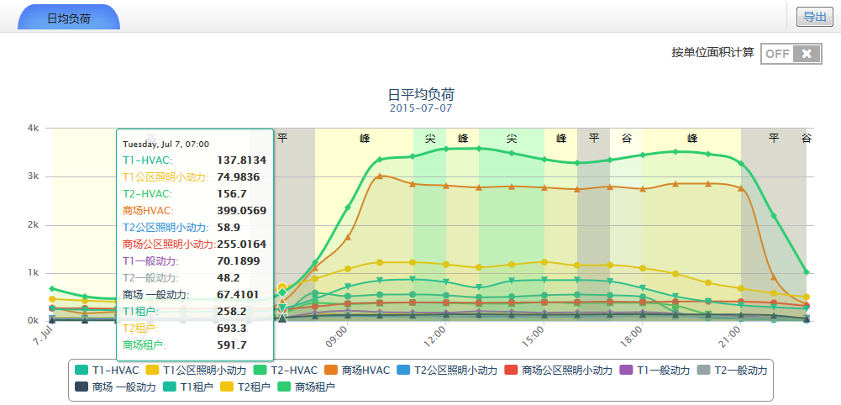
Average Daily Energy Report
shows energy use over a given day
Fig. 1. On a 4:3 projector setup a widescreen (16:9) slide with either have ‘dead-space’ above and below (left) or be stretched to fit (right) the projected area.

Slide 9
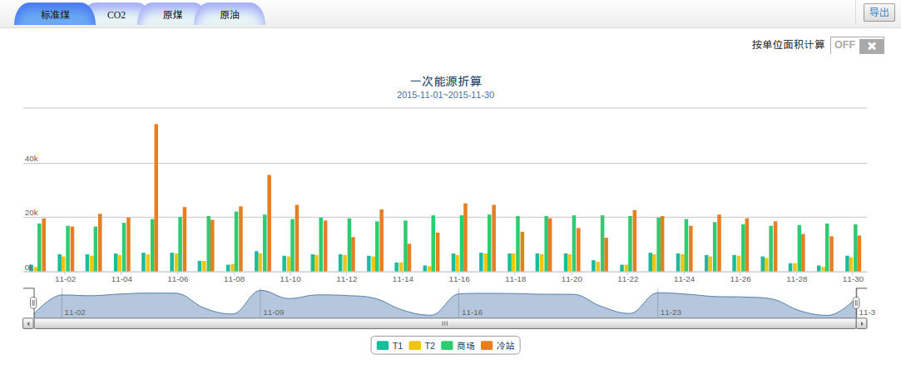
Primary Energy Report
converts and displays energy use in equivalent use of Coal, CO2, Oil, and Crude Coal.
Fig. 1. On a 4:3 projector setup a widescreen (16:9) slide with either have ‘dead-space’ above and below (left) or be stretched to fit (right) the projected area.

Slide 10
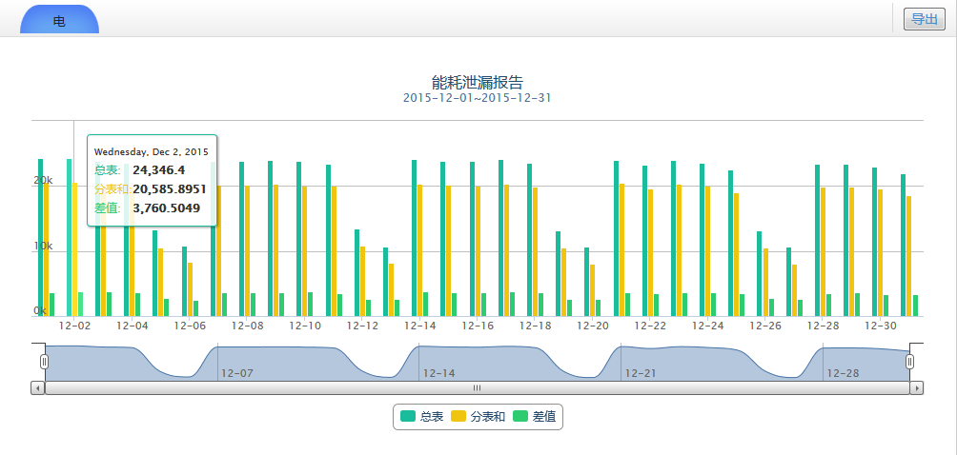
Energy Leak Report
shows energy use differences of master meters and meters
Fig. 1. On a 4:3 projector setup a widescreen (16:9) slide with either have ‘dead-space’ above and below (left) or be stretched to fit (right) the projected area.

Slide 11
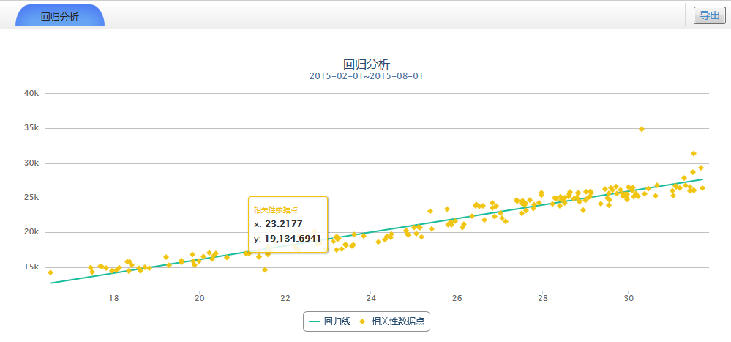
Energy Regression Analysis
shows regression analysis result for estimating the relationships among variables
Fig. 1. On a 4:3 projector setup a widescreen (16:9) slide with either have ‘dead-space’ above and below (left) or be stretched to fit (right) the projected area.

Slide 12
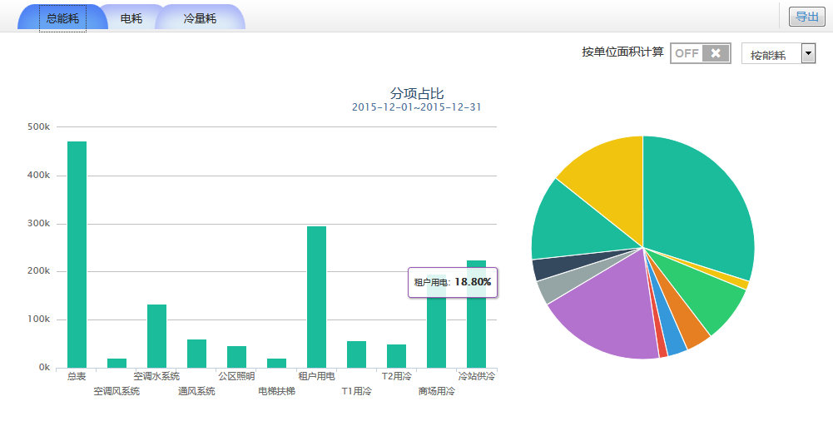
Energy Utilities Report
shows energy use by energy utilities
Fig. 1. On a 4:3 projector setup a widescreen (16:9) slide with either have ‘dead-space’ above and below (left) or be stretched to fit (right) the projected area.

Slide 13
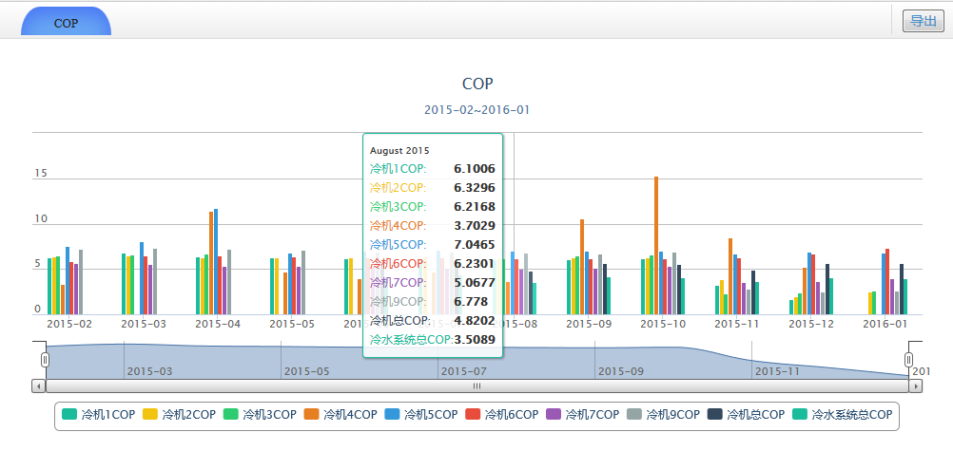
COP Report
shows Coefficient of Performance for chillers
Fig. 1. On a 4:3 projector setup a widescreen (16:9) slide with either have ‘dead-space’ above and below (left) or be stretched to fit (right) the projected area.

Slide 14
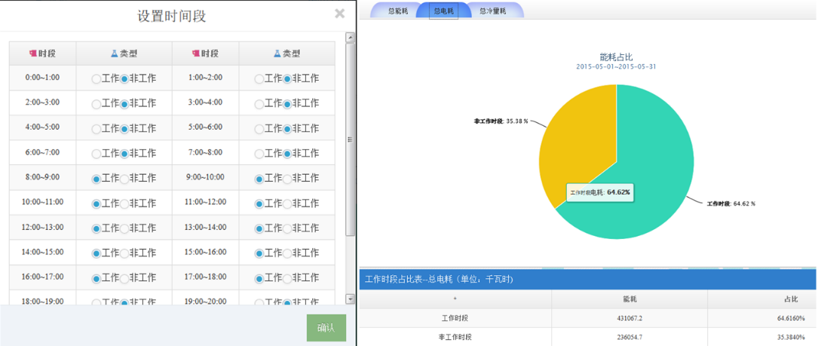
Working Hours Energy Report
shows energy use of working hours and off hours
Fig. 1. On a 4:3 projector setup a widescreen (16:9) slide with either have ‘dead-space’ above and below (left) or be stretched to fit (right) the projected area.

Slide 15
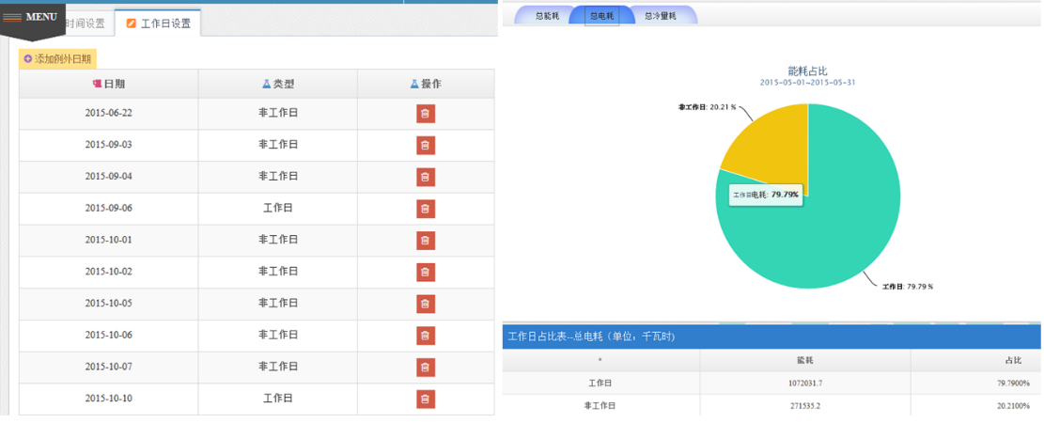
Working Days Energy Report
shows energy use of working days and holidays
Fig. 1. On a 4:3 projector setup a widescreen (16:9) slide with either have ‘dead-space’ above and below (left) or be stretched to fit (right) the projected area.

Slide 16
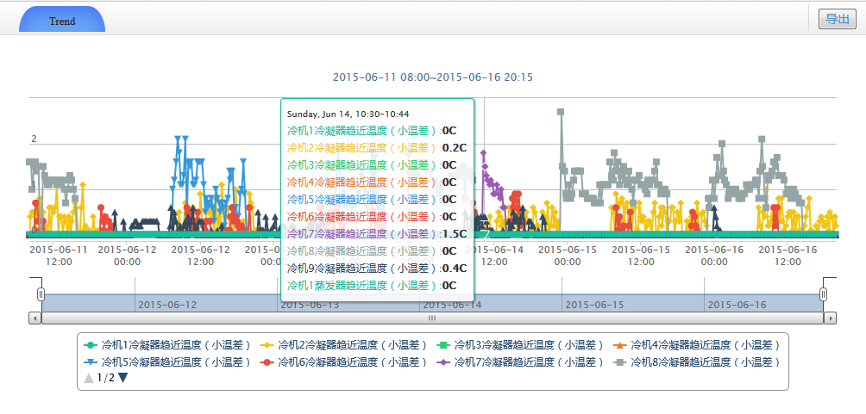
Trend
displays trends of sensors
Fig. 1. On a 4:3 projector setup a widescreen (16:9) slide with either have ‘dead-space’ above and below (left) or be stretched to fit (right) the projected area.

Slide 17
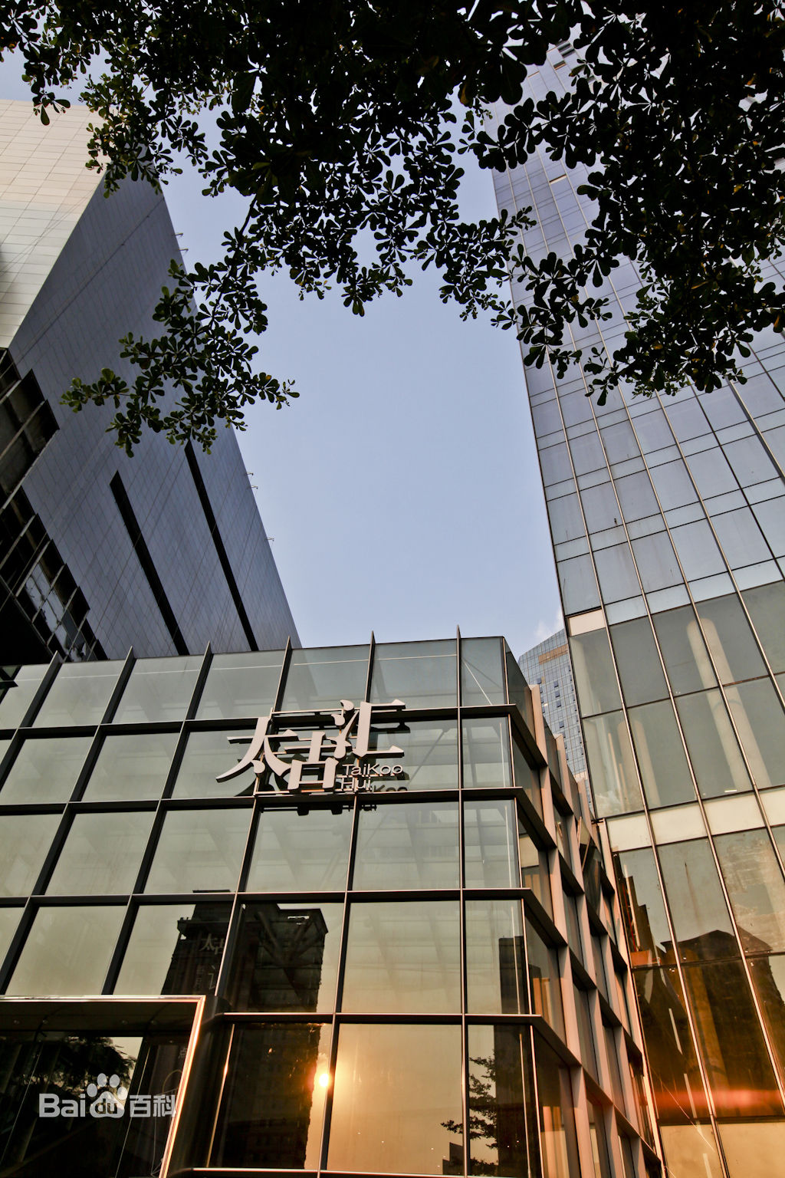
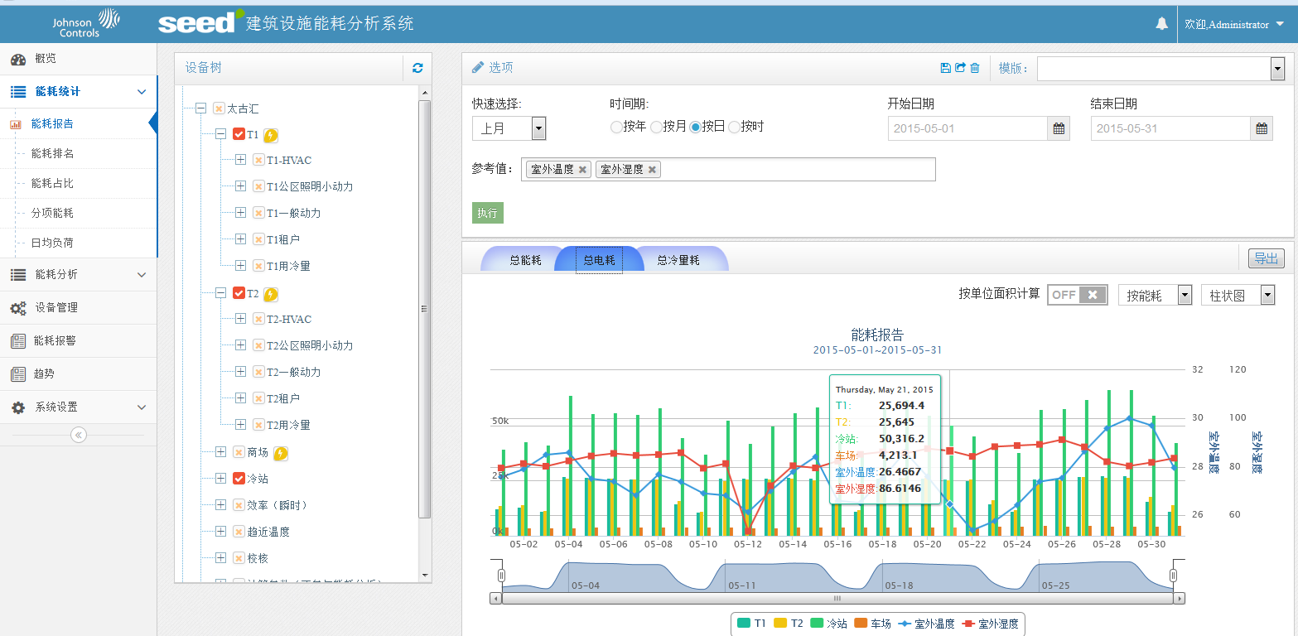
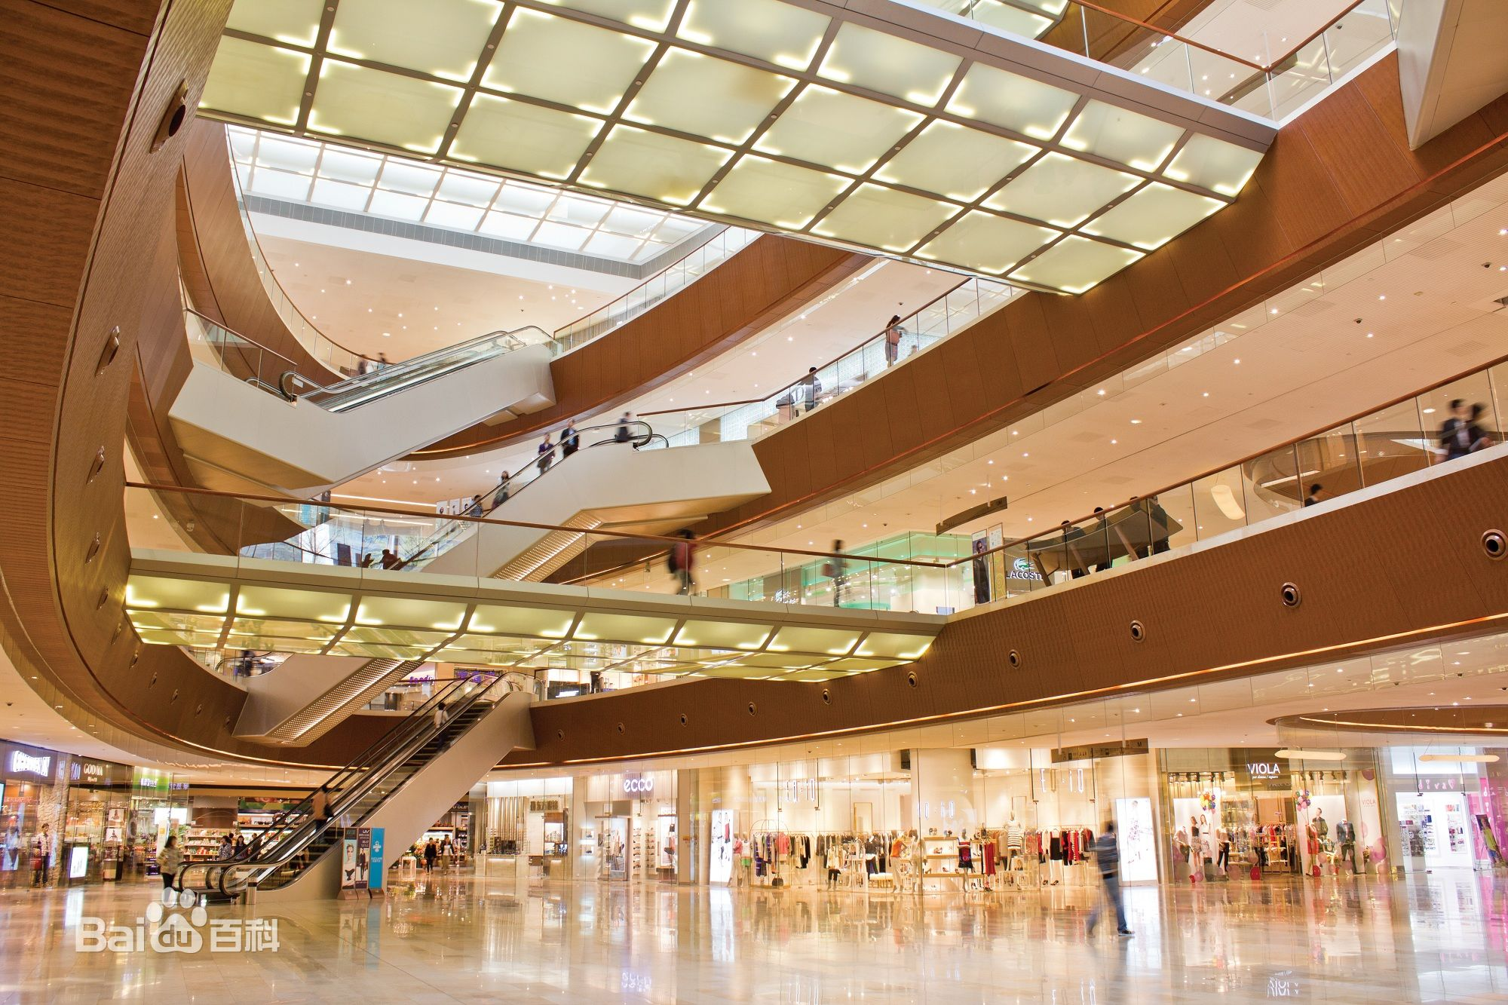
Case Study 1
TaiKoo Hui is a large-scale multi-faceted complex in the thriving heart of the Tianhe Central Business District of Guangzhou, developed and managed by Swire Properties. Offering a gross floor area of approximately 358,000 sqm (exclusive of the cultural center), it incorporates a prime shopping mall, two Grade A office towers, a cultural center, the first Mandarin Oriental Hotel in Guangzhou, and serviced apartments.
Fig. 1. On a 4:3 projector setup a widescreen (16:9) slide with either have ‘dead-space’ above and below (left) or be stretched to fit (right) the projected area.

Slide 18
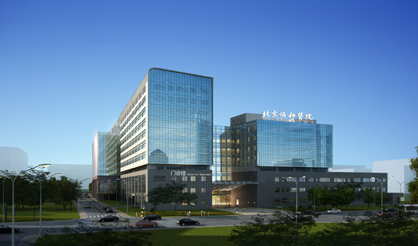
Case Study 2
New Outpatient Building of Peking Union Medical College Hospital
Peking Union Medical College Hospital (PUMCH) is a Class A tertiary comprehensive hospital committed to delivering state-of-the-art clinical care, innovative scientific research and rigorous medical education. It is designated by the National Health and Family Planning Commission as one of the national referral centers offering diagnostic and therapeutic care of complex and rare disorders, as well as one of the earliest Chinese hospitals offering medical care to senior leaders and foreign patients. PUMCH enjoys high reputation for its full range of disciplines, cutting-edge technologies and outstanding specialties.

Slide 19
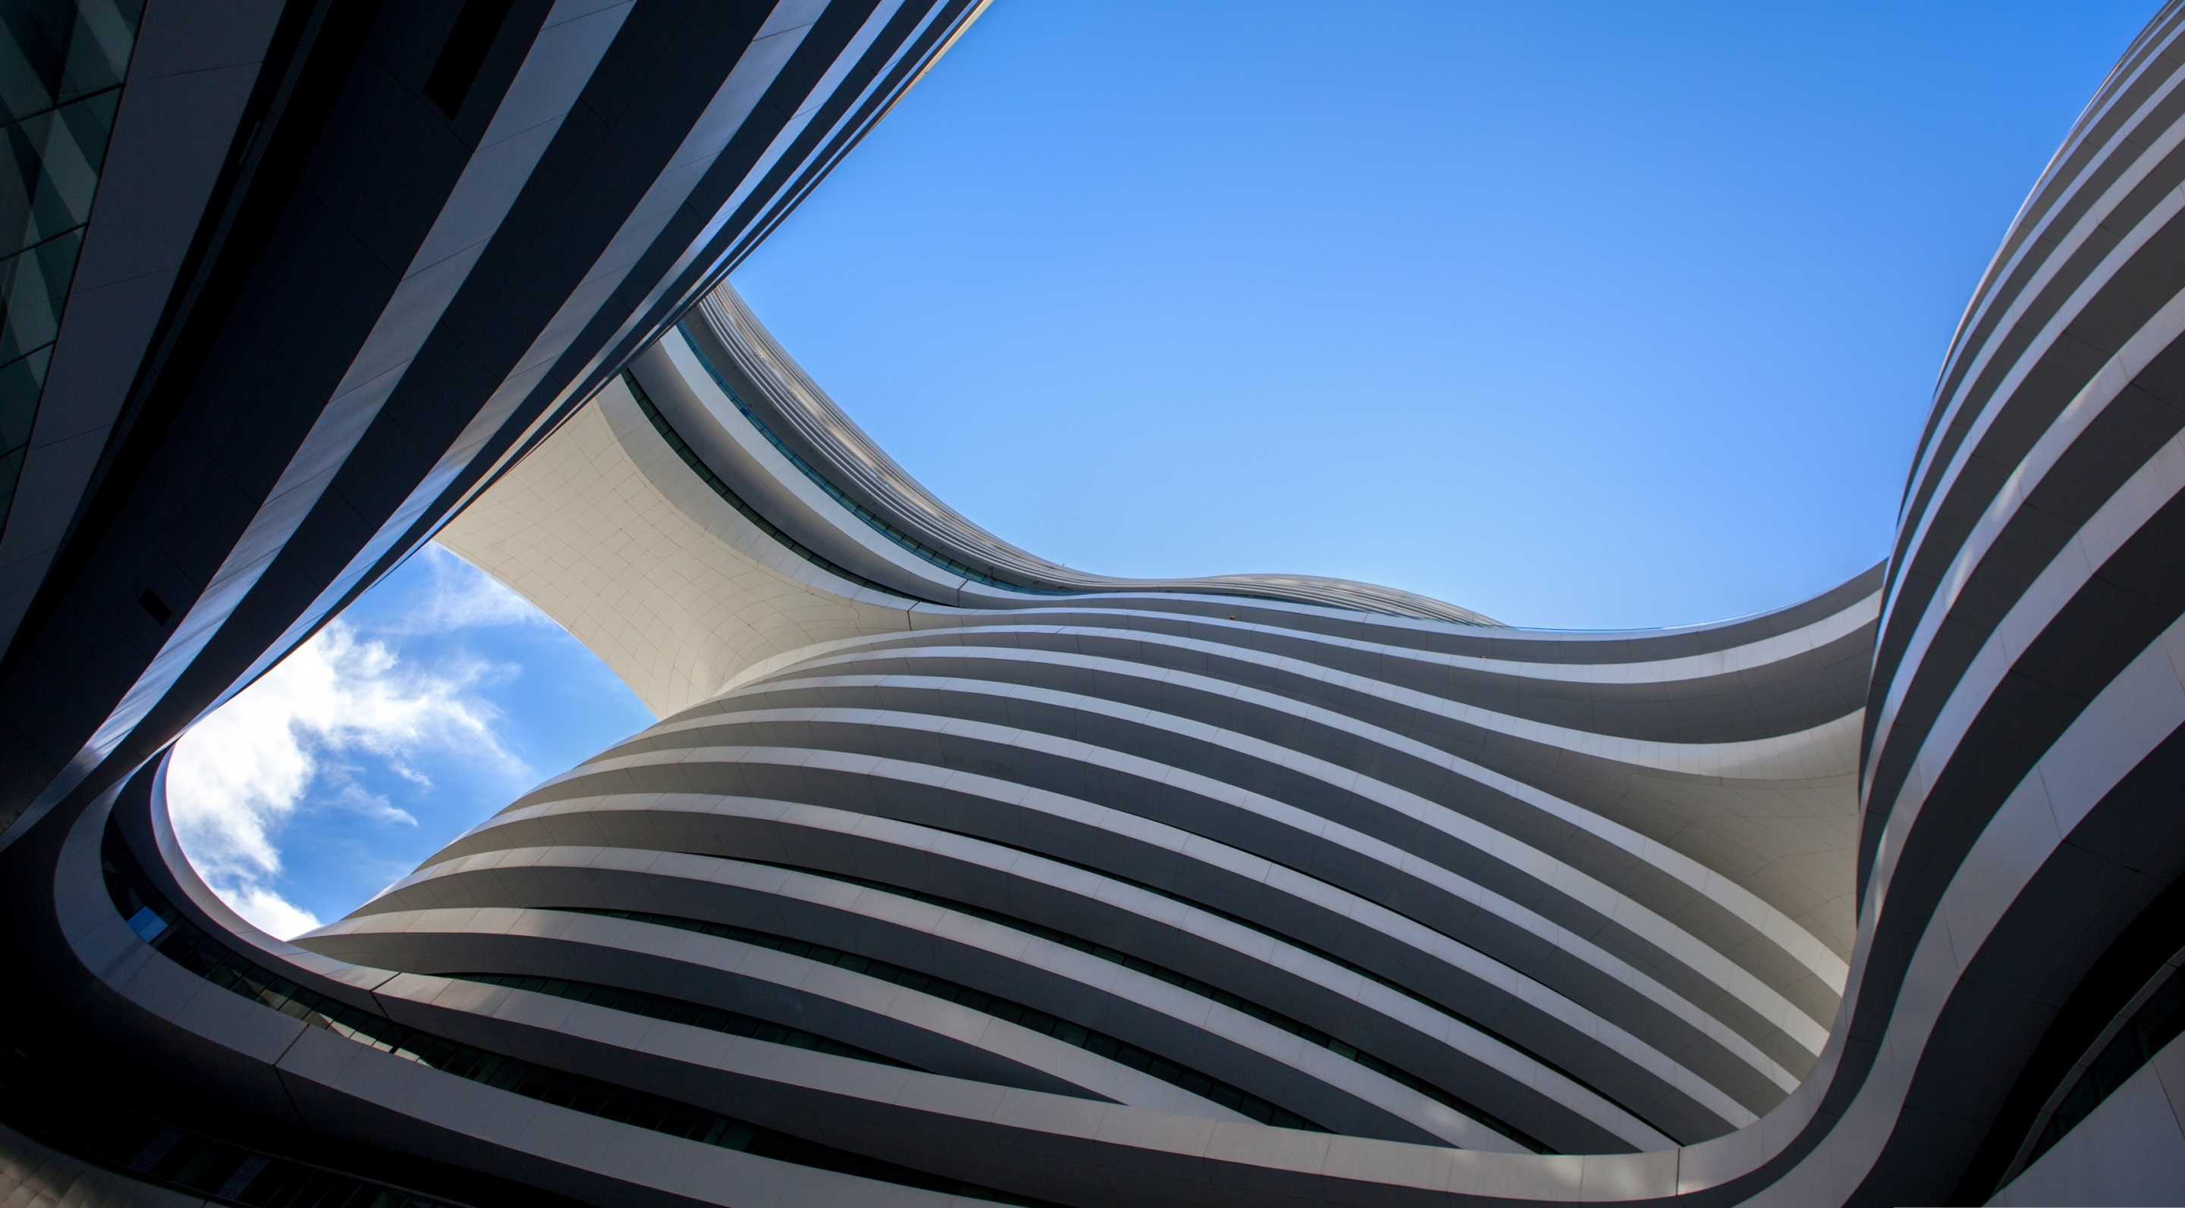
Engineered Systems & Solutions
Building Efficiency
Johnson Controls

